Slide 1





Digital Self-Defense in a Post-Roe World
OWASP-Ottawa Training Track
Presented by Abigail Dubiniecki
Lawyer & Privacy Pro
November 28, 2022
Abigail Dubiniecki 2022

Slide 2

OVERVIEW
TOPICS
01
Statement of the Problem - The Fallout from Roe
02
What is Privacy?
03
What are the digital privacy risks post-Roe?
04
What role do developers & their clients play?
Abigail Dubiniecki 2022

Slide 3
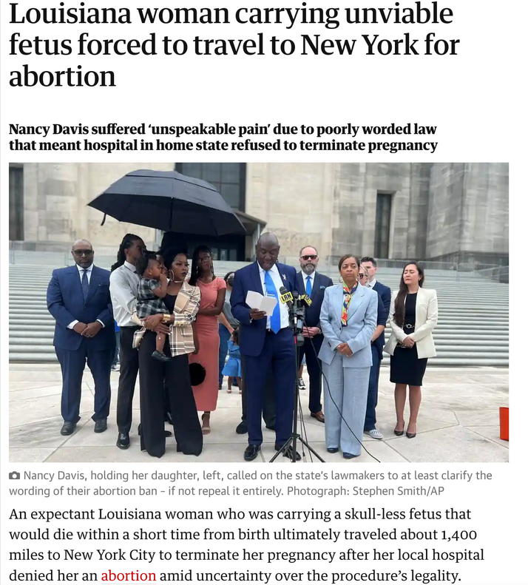

ROE GETS REAL
Bodily privacy & data privacy collided in the US Supreme Court's overturning of Roe v. Wade. Suddenly the privacy implications of our digital reality became very real. People are deleting period-tracking apps & thinking twice about their online searches or even messages they send in private chats.
Abigail Dubiniecki 2022

Slide 4




ROE GETS REAL
Abigail Dubiniecki 2022

Slide 5
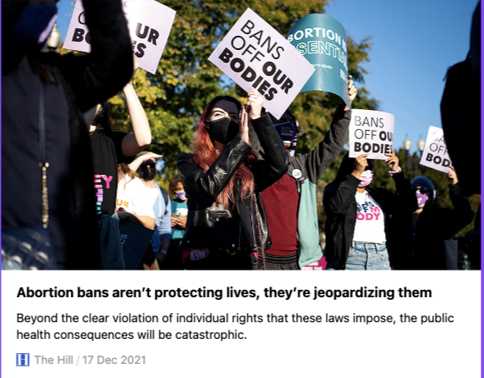
Abortion bans don't prevent abortion, they prevent safe abortion. They also increase health & other risks:
Increase in domestic abuse
Higher maternal & infant mortality
Pre-term birth / low birthweight
Neglect, abuse, poverty
The 14 most restrictive states invest the least in women's & children's health
Disproportionately impact Black & marginalized people & has White Supremacist origins.
IT'S NOT ABOUT PROTECTING LIFE...
it's about control.
THE RACIST ORIGINS OF ABORTION & MIDWIFERY BANS
WHY ABORTION BANS DISPROPORTIONATELY AFFECT PEOPLE OF COLOUR
Abigail Dubiniecki 2022

Slide 6
FORCED BIRTH, FORCED STERILIZATION, FORCED FAMILY SEPARATION
Restrictions on reproductive rights undermine bodily autonomy & integrity, human dignity & self-determination
Abigail Dubiniecki 2022

Slide 7
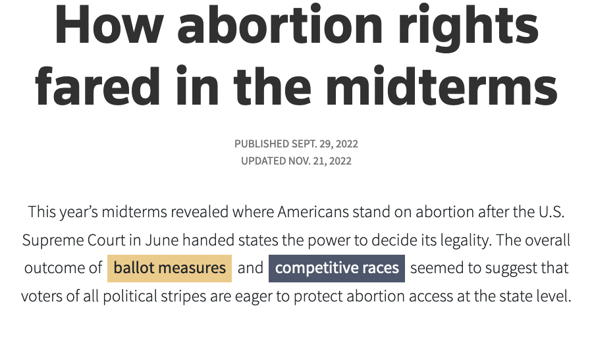


VOTERS VOTED FOR PRIVACY
time.com/6231550/how-abortion-helped-blunt-a-red-wave-in-the-midterms
www.reuters.com/graphics/USA-ELECTION/ABORTION/zdpxoldbkvx/index.html
It delivered "...unified control of a state Donald Trump won in 2016 [Michigan] for the first time in almost 40 years. “
Abigail Dubiniecki 2022

Slide 8


WHAT IS
PRIVACY?
Photo by Mr Xerty on Unsplash
Abigail Dubiniecki 2022

Slide 9
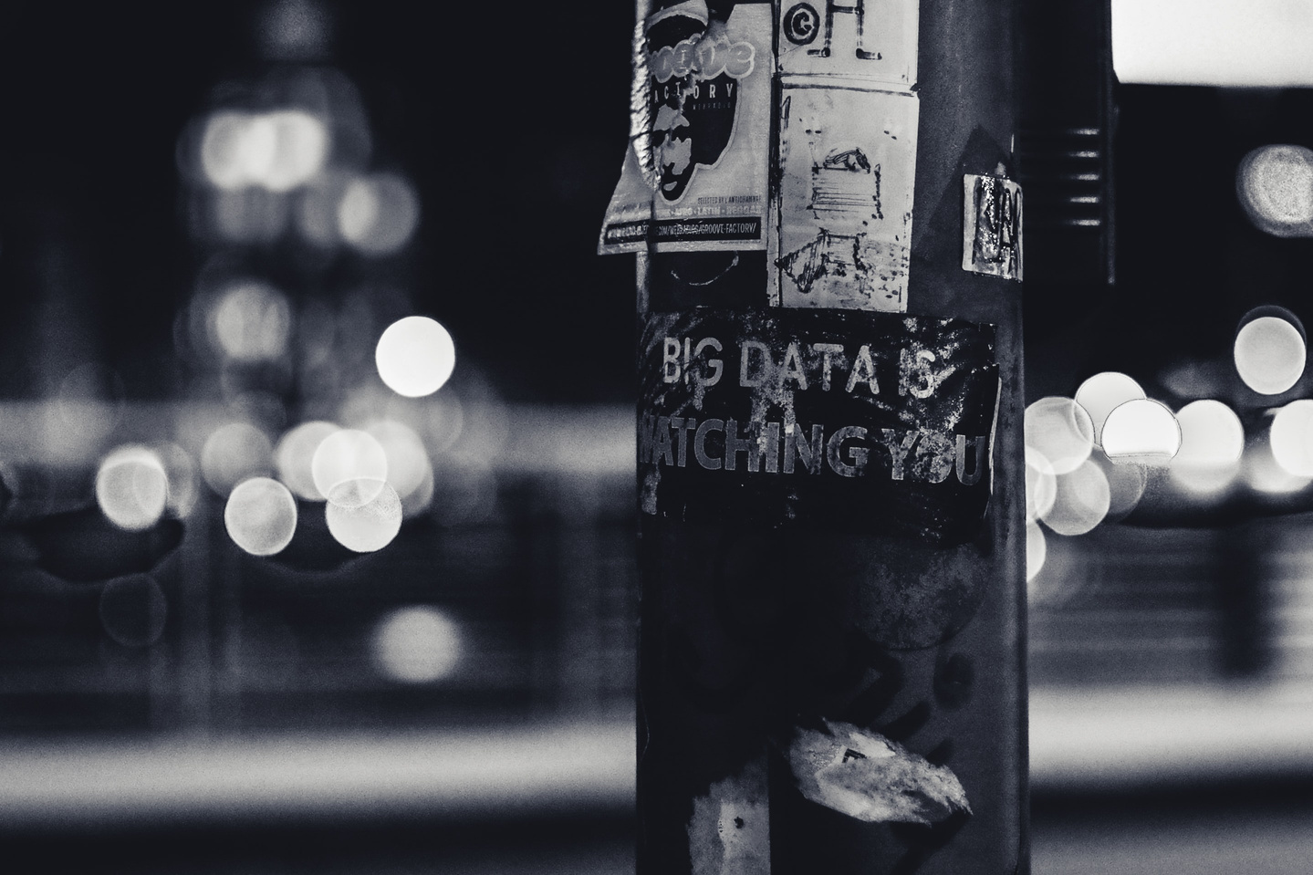

It's NOT about keeping
SECRETS
Photo by ev on Unsplash
Abigail Dubiniecki 2022

Slide 10


limit collection
be honest
be accountable
sharing is not caring
TRANSPARENCY & ACCESSIBILITY
FOR YOU & YOUR SERVICE PROVIDERS
TO WHAT'S STRICTLY NECESSARY
LIMIT USE, DISCLOSURE & RETENTION
identify your purpose
Privacy Laws
keep it accurate
FAIR INFO PRINCIPLES
GARBAGE IN, GARBAGE OUT
NO CLEAR PURPOSE? NO PERSONAL INFO
FOCUS ON DATA PRIVACY
it's their data
get consent
oops!
MAKE ACCESS EASY & RESPECT RIGHTS
MEANINGFUL CONSENT MEANS REAL CHOICE
keep it secure!
SEE COMPLAINTS AS AN CHANCE TO ENGAGE
ASSESS & MITIGATE RISKS
Abigail Dubiniecki 2022

Slide 11
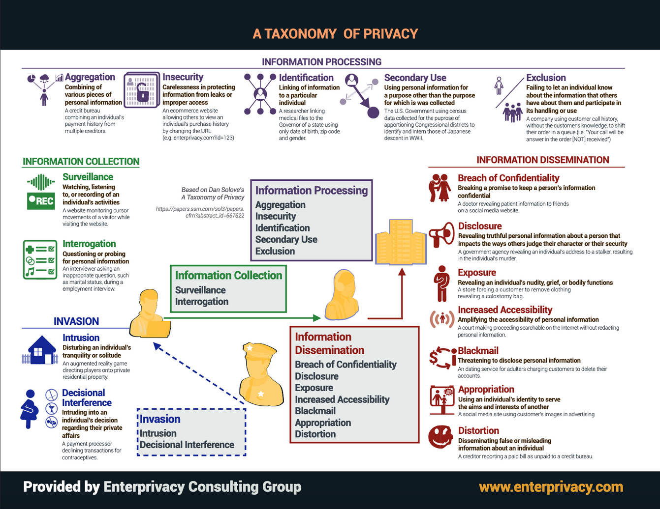
our data
IS NOT AN ORDINARY COMMODITY.
IT'S AN EXTENSION OF OURSELVES.
BUT PRIVACY HARMS GO BEYOND DATA.
Privacy is about Self-Determination & Dignity
NOT JUST DATA
irl
WE PAY A STEEP PRICE....
IN REAL LIFE.

Slide 12
SOME PRIVACY HARMS
& CONSEQUENCES
surveillance
interrogation
decisional interference
intrusion
extortion
exposure
distortion
reputation harm, interference
violence
modify behaviour; lose trust
undermines freedom, choice
emotional "tax", burden, intimidation
"Delete your fertility apps!"
Angry protestors outside clinic
"Kill list" for journalists
Birth alerts
Doxxing
Abigail Dubiniecki 2022

Slide 13
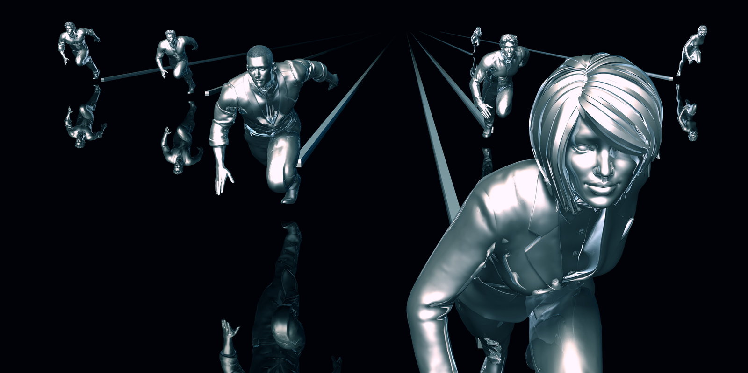





Informational
SELF-DETERMINATION
Abigail Dubiniecki 2022

Slide 14

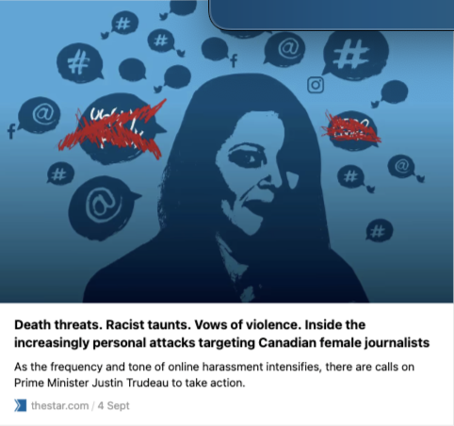


Examples of Online Harms
VICTIM'S FAMILY TERRORIZED
Reputation of Indigenous woman killed by white 17 year-old distorted w/misinfo by Thunder Bay FB Group. Grieving family doxxed & harassed.
Trans activist was harassed & doxxed by Kiwi Farms users. "Intention is to disconnect you from all sources of support."
Journalists quit, move, or second-guess what they write about, fear for their lives. An "emotional tax"
Abigail Dubiniecki 2022

Slide 15

HOW DOES ROE IMPACT
DIGITAL PRIVACY?
Abigail Dubiniecki 2022

Slide 16
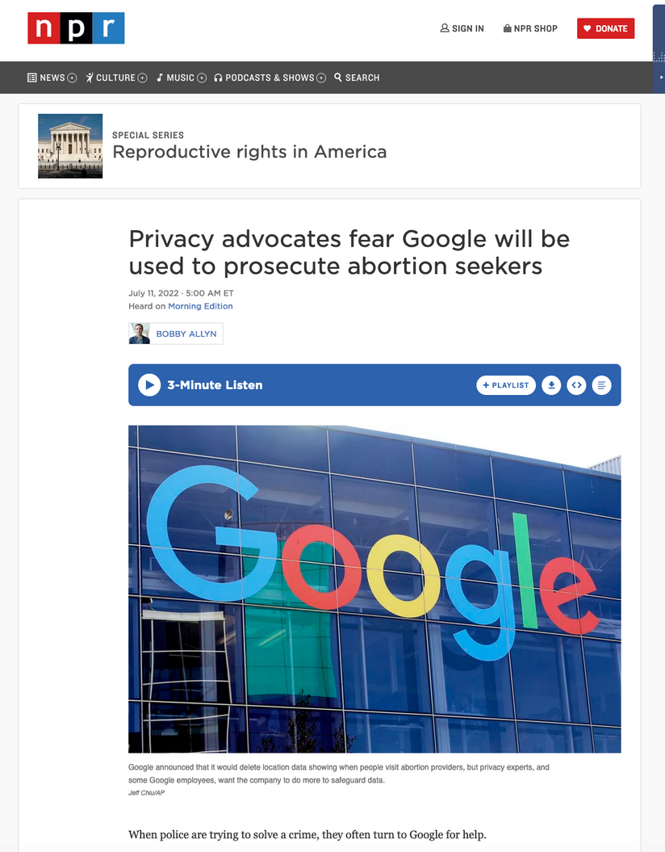
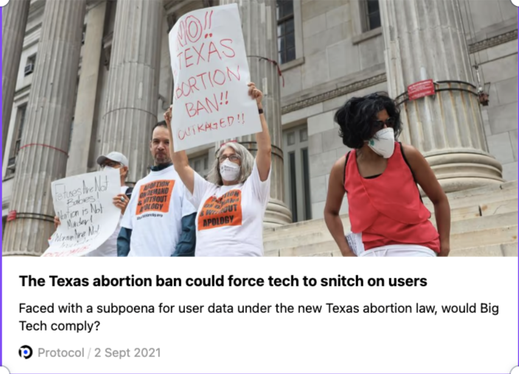
LAW ENFORCEMENT
Abigail Dubiniecki 2022

Slide 17

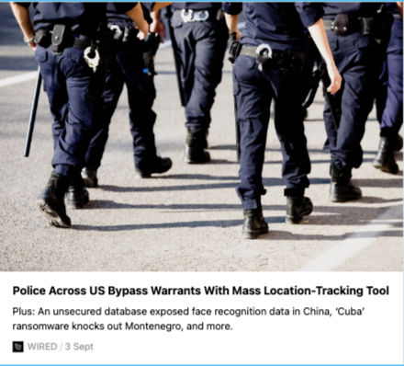
LAW ENFORCEMENT*
*no warrant required!
"...anyone with the inclination and a credit card could access granular data about abortion clinics from public sites like SafeGraph and Placer.ai."

Slide 18
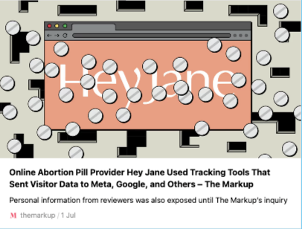

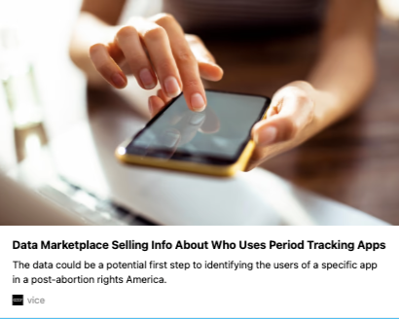
even the helpers can harm
Review APIs, Analytics code, Pay gateways track visitors, gobble data.
UNINTENDED SHARING
Websites are built for sharing. Plugins are by nature "leaky" because they can send sensitive data across the dataverse with few, if any, restrictions.
Clue tracks your period. So do shady data brokers & their clients.
Abigail Dubiniecki 2022

Slide 19

Sometimes the harm is...
INTENTIONAL
Abigail Dubiniecki 2022

Slide 20

WHAT'S ALL THE DATA FOR?
TARGETING ADS...
AND
...DISINFORMATION
(c) Abigail Dubiniecki 2022

Slide 21
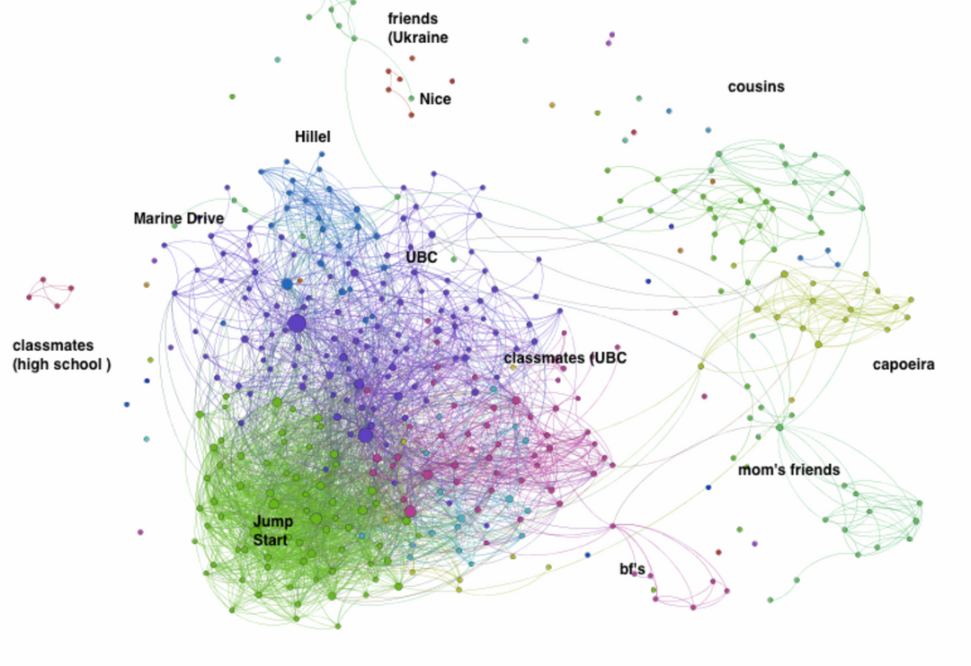
Where do they get all the data?
Your website.
Your app.
Your mailing list.
Your "Smart" speaker, camera, wearable....
Your likes.
Your views.
Your groups.
Your photos.
Your contact list.
(c) Abigail Dubiniecki 2022

Slide 22


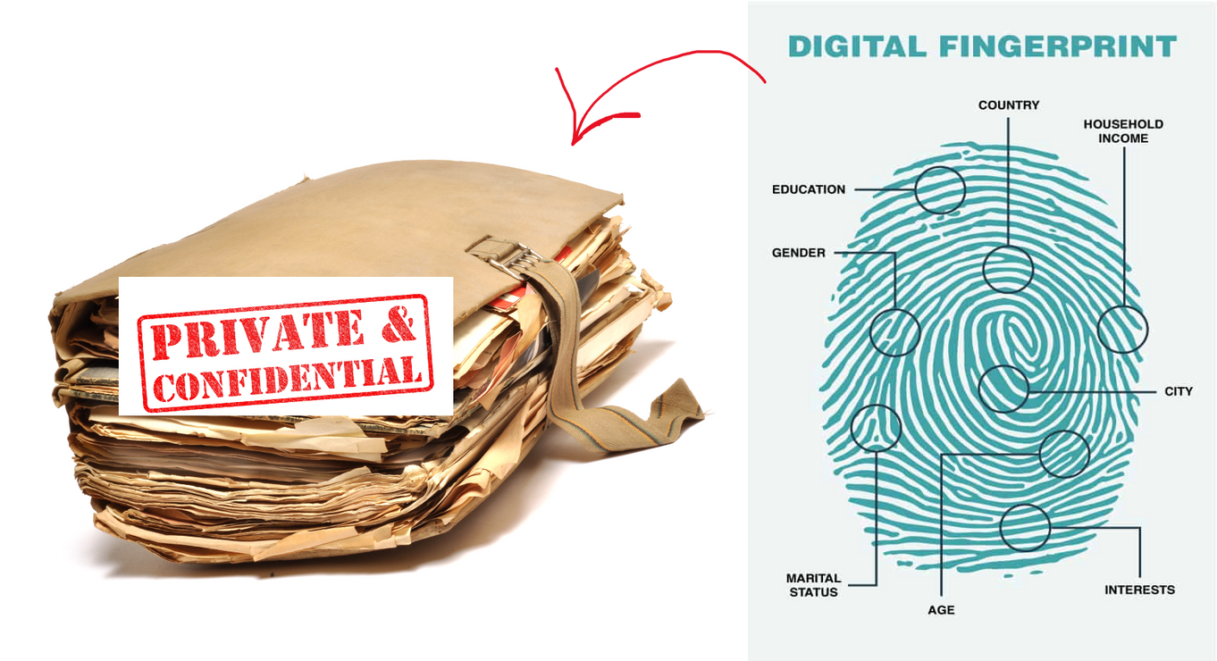
We leave digital traces wherever we go.
A digital cookie crumb trail....
Abigail Dubiniecki 2022

Slide 23
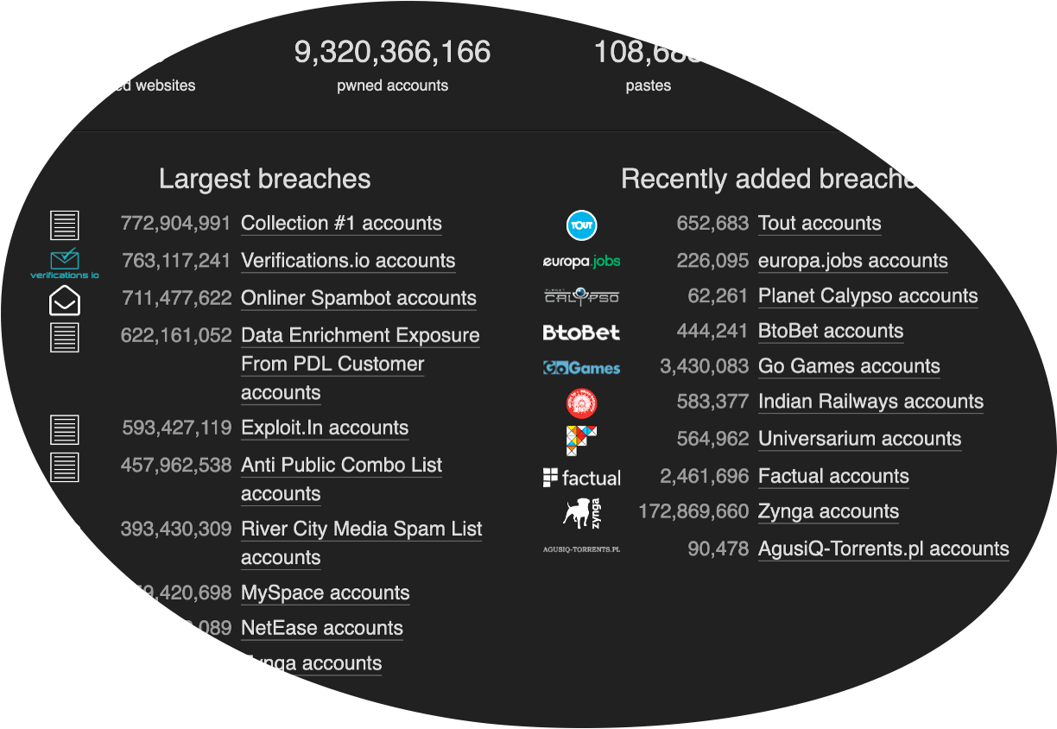
Breaches
Abigail Dubiniecki 2022

Slide 24
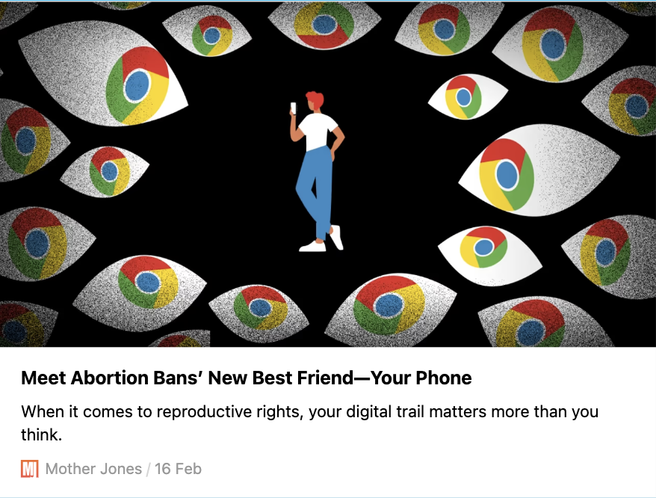
Your phone is a
SNITCH
What about your
Roomba
Smart TV
Fitbit?
Abigail Dubiniecki 2022

Slide 25

SHOSHANA ZUBOFF
sur-veil-lance cap-i-tal-ism, n.
A NEW ECONOMIC ORDER THAT CLAIMS HUMAN EXPERIENCE AS FREE RAW MATERIAL FOR HIDDEN COMMERCIAL PRACTICES OF EXTRACTION, PREDICTION, AND SALES; 2. A PARASITIC ECONOMIC LOGIC IN WHICH THE PRODUCTION OF GOODS AND SERVICES IS SUBORDINATED TO A NEW GLOBAL ARCHITECTURE OF BEHAVIOURAL MODIFICATION; 3. A ROGUE MUTATION OF CAPITALISM MARKED BY CONCENTRATIONS OF WEALTH, KNOWLEDGE, AND POWER UNPRECEDENTED IN HUMAN HISTORY; 4. THE FOUNDATIONAL FRAMEWORK OF A SURVEILLANCE ECONOMY; 5. AS SIGNIFICANT A THREAT TO HUMAN NATURE IN THE TWENTY-FIRST CENTURY AS INDUSTRIAL CAPITALISM WAS TO THE NATURE IN THE TWENTY-FIRST CENTURY AS INDUSTRIAL CAPITALISM WAS TO THE NATURAL WORLD IN THE NINETEENTH AND TWENTIETH; 6. THE ORIGIN OF A NEW INSTRUMENTARIAN POWER THAT ASSERTS DOMINANCE OVER SOCIETY AND PRESENTS STARTLING CHALLENGES TO MARKET DEMOCRACY; 7 A MOVEMENT THAT AIMS TO IMPOSE A NEW COLLECTIVE ORDER BASED ON TOTAL CERTAINTY;
8. AN EXPROPRIATION OF CRITICAL HUMAN RIGHTS THAT IS BEST UNDERSTOOD AS A COUP FROM ABOVE: AN OVERTHROW OF THE PEOPLE'S SOVEREIGNTY.
(c) Abigail Dubiniecki 2022

Slide 26

The invisible ‘editors’ of today’s information ecosystem are the opaque algorithms and recommender systems built by tech companies that track and target us. They amplify misogyny, racism, hate, junk science and disinformation – weaponizing every societal fault line with relentless surveillance to maximize “engagement”. This surveillance-for-profit business model is built on the con of our supposed consent. But forcing us to choose between allowing platforms and data brokers to feast on our personal data or being shut out from the benefits of the modern world is simply no choice at all. The vast machinery of corporate surveillance not only abuses our right to privacy, but allows our data to be used against us, undermining our freedoms and enabling discrimination.
Maria Ressa, People vs Tech 10-Step Plan
Abigail Dubiniecki 2022

Slide 27
What role do organisations & developers play?
STOP FEEDING THE BEAST!!
You vote with your clicks, your likes, shares and ad-spend.
Abigail Dubiniecki 2022

Slide 28


Ask the Right Questions. Think before you click.
Why do I need this product or service?
What data will it capture?
Why & how will
it be used?
Is there a less privacy-invasive alternative?
Strip away any data "bloat". Disable unnecessary plugins, vet libraries & SDKs, choose privacy-preserving dev frameworks, GITs, privacy patterns.
Consider the full lifecycle, the data supply chain and the vendor ecosystem. Whose interests are really being served? Are you doing what you say do?
What's your end game? How does this service help you achieve that goal while remaining true to your values?
Only use what necessary & proportionate. Minimize risks. Use privacy tech in place of surveillance tech.
Abigail Dubiniecki 2022

Slide 29
3-Step Harm Reduction Plan
Sounds good. But how?
1
take stock
of what you're collecting or allowing to be collected versus what you actually need.
2
take trim the fat
cut out any unnecessary data collection or surveillance activities. Tighten controls on your vendors.
It's really hard to build a business without relying on data-hungry tech
3
give back control
integrate privacy-first or privacy-enhancing technologies. Make it easy for your users to regain control. Explain how.
Abigail Dubiniecki 2022

Slide 30
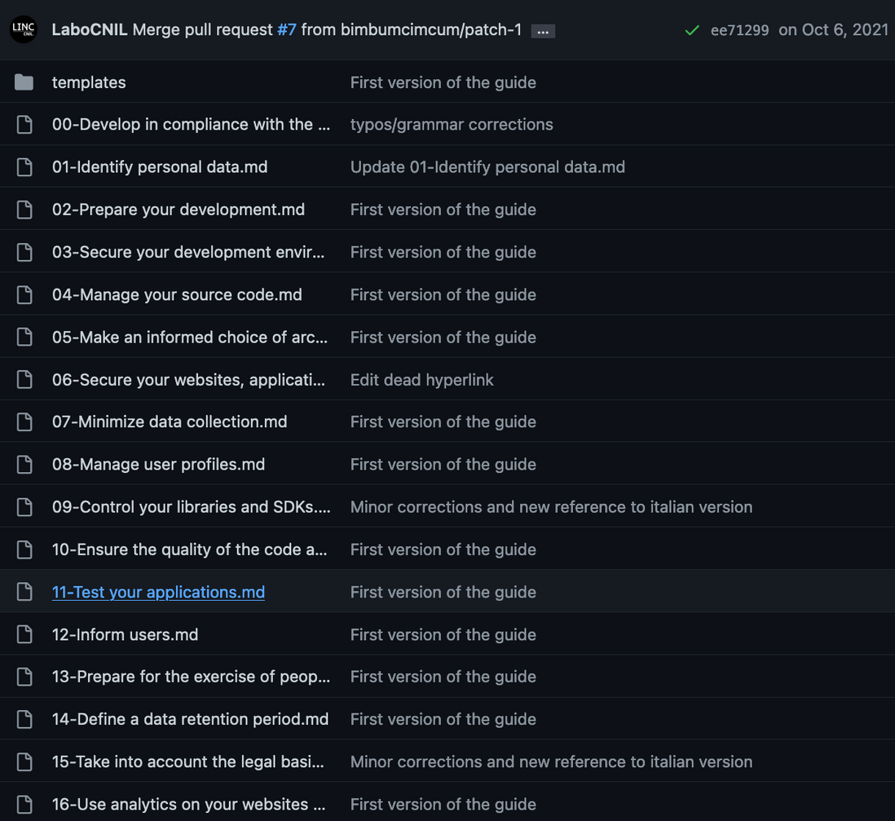
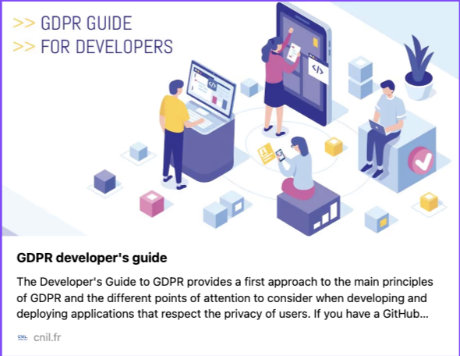
Bake Privacy In
The devil is in the code

Slide 31
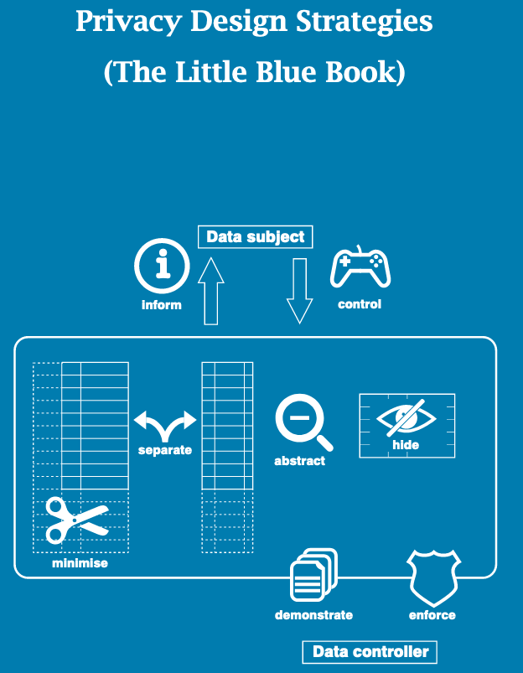
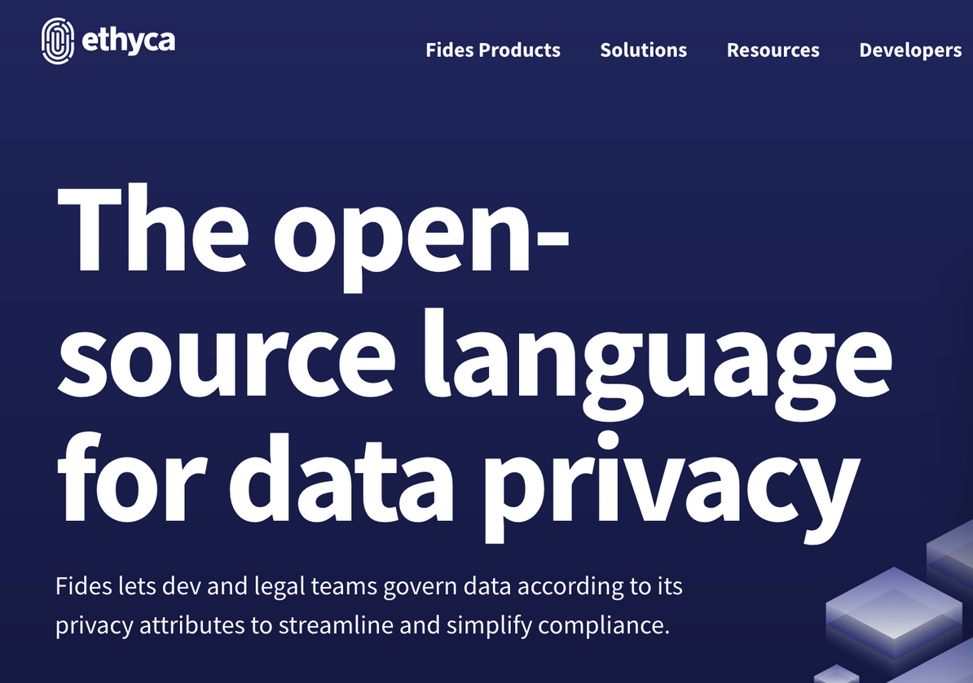

Bake Privacy In
At code-level, and in system architectur, in your data flows in addition to your policies
ethyca.com/fides
www.cs.ru.nl/~jhh/publications/pds-booklet.pdf
Abigail Dubiniecki 2022

Slide 32
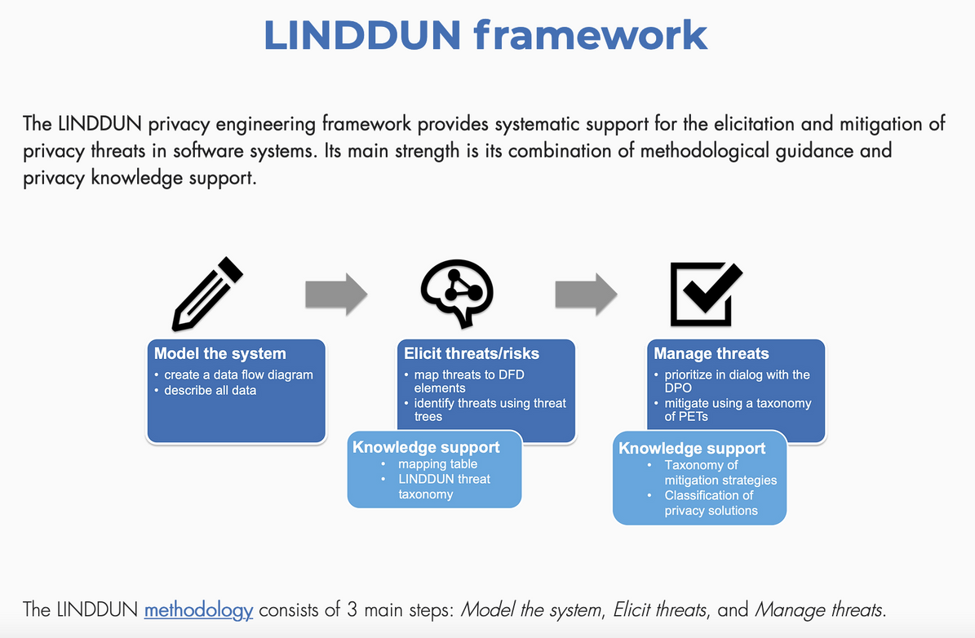

Privacy Engineering
PRIVACY THREAT MODELING
STRIDE-inspired
Gamified version: LINDDUN.org/GO
Abigail Dubiniecki 2022

Slide 33







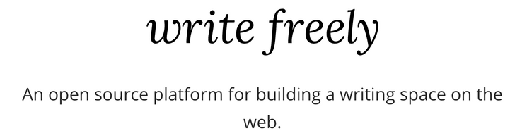

analyse
WITHOUT SURVEILLANCE
engage
WITHOUT BEING CREEPY
advertise
FAIRLY & EFFECTIVELY
own the room
REACH OUT TO YOUR AUDIENCES
Abigail Dubiniecki 2022

Slide 34
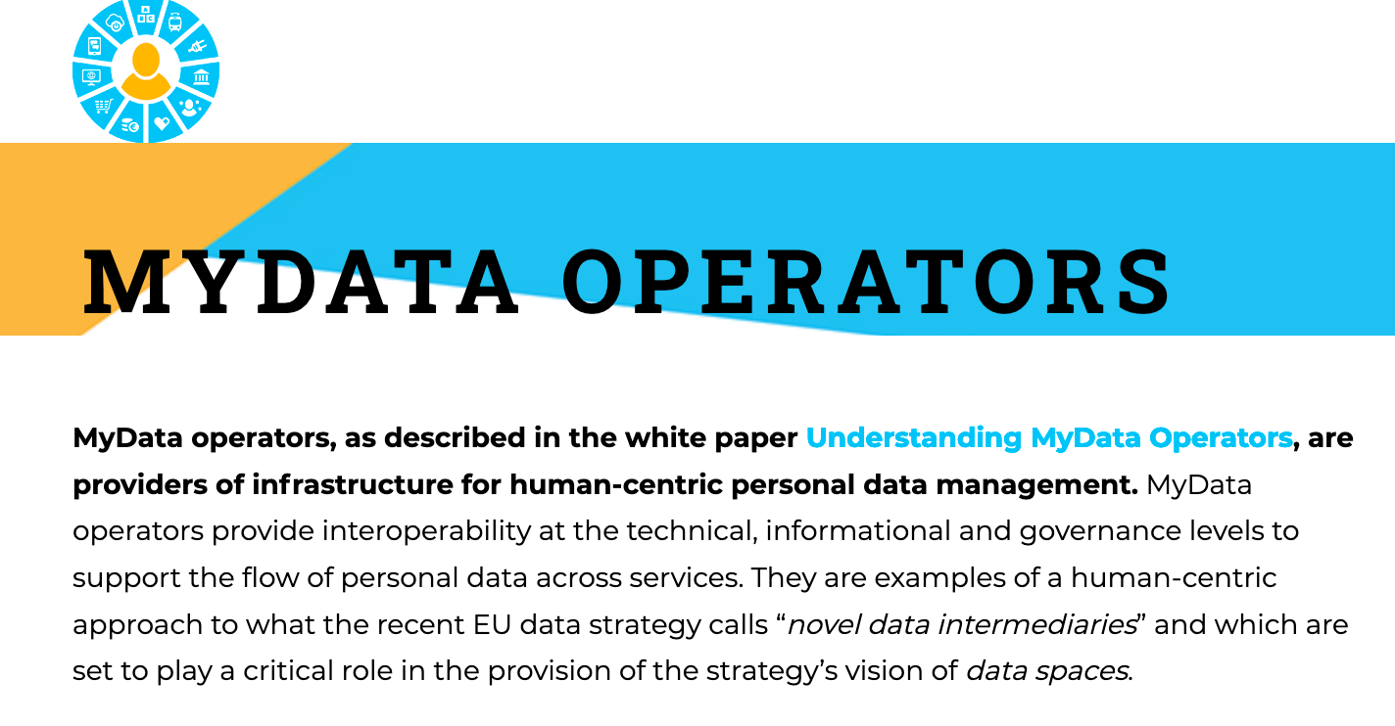
Click the image for the full list or visit mydata.org/mydata-operators/to learn more.
Abigail Dubiniecki 2022

Slide 35
Great... in theory
BUT WILL I STILL BE
COMPETITIVE?
Abigail Dubiniecki 2022

Slide 36
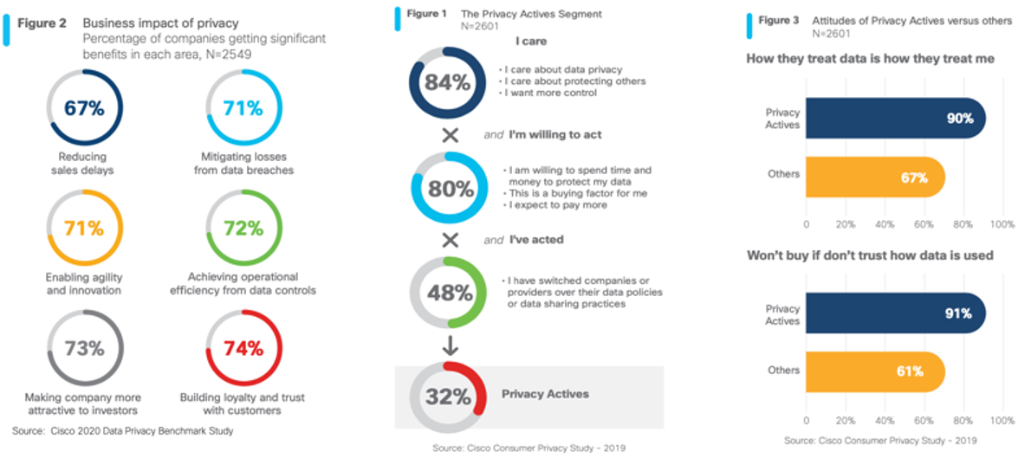
Yes!
Abigail Dubiniecki 2022

Slide 37
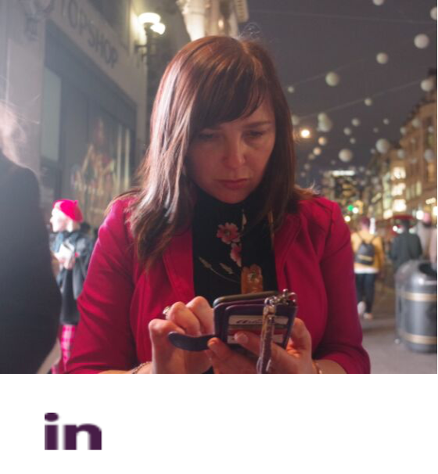


Lawyer & Certified Privacy Geek
B.Ed., B.C.L., LL.B.
Speaker, Trainer, Writer
Member,
MyData Canada
@LegallyAbigail
@LegallyAbigail@dair-community.social
Abigail Dubiniecki 2022

